Slide 1
RGB-D Object Detection using the Fast R-CNN
Xiaoqiang Yan
CICS, UMass Amherst

Slide 2
Introduction
Architecture
Fast R-CNN [Girshick ICCV 2015]
Modalities
RGB modality
Depth modality (disparity or HHA* [Gupta et al. ECCV 2014])
Database: NYUD2 [Silberman et al ECCV 2012]
759 image pairs in training set
654 image pairs in testing set
*HHA: Horizontal disparity, Height above ground, Angle with gravity [Gupta et al. ECCV 2014]
RGB-D Object Detection using the Fast R-CNN
-Xiaoqiang Yan (CICS, UMass Amherst)

Slide 3
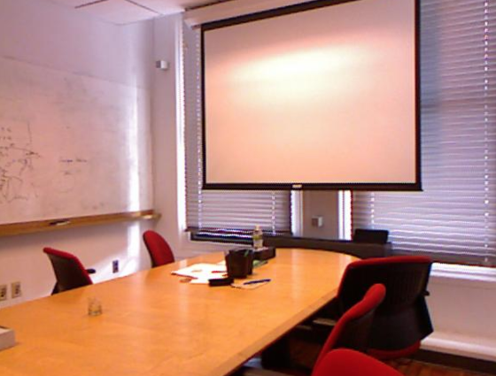
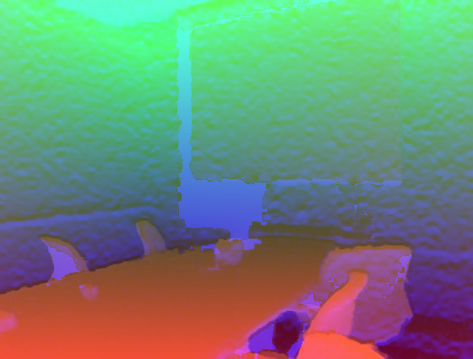
Architecture
ROI Pooling
Softmax Classifier
Conv
BBox Regression
Image+Proposal
Feature Map
FC layers
Softmax Classifier
Conv
BBox Regression
RGB-D Object Detection using the Fast R-CNN
-Xiaoqiang Yan (CICS, UMass Amherst)

Slide 4
Technical Approach
RGB stream
Finetune using ImageNet pre-trained VGG16
Depth stream
Finetune using ImageNet pre-trained VGG16 on disparity images
Finetune using ImageNet pre-trained VGG16 on HHA images
Combining RGB and depth streams
Average final scores
Joint training
RGB-D Object Detection using the Fast R-CNN
-Xiaoqiang Yan (CICS, UMass Amherst)

Slide 5
Joint Training Architecture
ROI Pooling
Conv
Softmax Classifier
FC6 FC7
Image+Proposal
Feature Map
Concatenate
BBox Regression
Conv
RGB-D Object Detection using the Fast R-CNN
-Xiaoqiang Yan (CICS, UMass Amherst)

Slide 6
Comparisons of Single Modalities
Category | bathtub | bed | bookshelf | box | chair | counter | desk | door | dresser | garbage-bin
RGB | 25.2 | 65.5 | 46.9 | 2.62 | 42.3 | 44.7 | 13.5 | 26.6 | 38.8 | 36.3
Disparity | 24.4 | 68.9 | 25.0 | 0.32 | 38.0 | 39.2 | 6.11 | 8.73 | 21.5 | 11.5
HHA | 30.5 | 74.3 | 29.0 | 0.94 | 38.9 | 44.1 | 13.3 | 11.0 | 37.7 | 20.8
Category | lamp | monitor | night- stand | pillow | sink | sofa | table | TV | toilet | mean
RGB | 32.5 | 43.8 | 31.8 | 30.5 | 39.9 | 44.5 | 21.6 | 47.6 | 51.5 | 36.1
Disparity | 24.7 | 8.92 | 38.7 | 19.9 | 23.1 | 45.6 | 21.3 | 6.83 | 31.7 | 24.4
HHA | 28.7 | 29.4 | 34.8 | 36.3 | 28.3 | 52.8 | 23.9 | 15.3 | 59.4 | 32.1
RGB-D Object Detection using the Fast R-CNN
-Xiaoqiang Yan (CICS, UMass Amherst)

Slide 7
Combining RGB and HHA modalities
Category | bathtub | bed | bookshelf | box | chair | counter | desk | door | dresser | garbage-bin
Average Score | 43.1 | 78.9 | 49.0 | 3.20 | 48.7 | 56.0 | 19.1 | 26.1 | 54.1 | 43.1
Joint Training | 41.2 | 78.6 | 46.2 | 2.74 | 50.5 | 55.7 | 17.8 | 28.1 | 50.6 | 39.4
Category |  | lamp | monitor | night- stand | pillow | sink | sofa | table | TV | toilet | mean
Average Score |  | 38.7 | 53.6 | 48.7 | 42.3 | 44.3 | 58.7 | 28.4 | 43.9 | 69.2 | 44.7
Joint Training |  | 38.9 | 52.7 | 45.5 | 45.1 | 40.4 | 58.0 | 30.5 | 50.4 | 66.8 | 44.2
RGB-D Object Detection using the Fast R-CNN
-Xiaoqiang Yan (CICS, UMass Amherst)

Slide 8
Single vs Two Modalities
Input Modality | RGB | HHA | HHA (scratch) | RGB+ HHA
mAP | 36.1 | 32.1 | 0.0* | 44.7
*I was unable to get meaningful results for HHA using random initialization within 10K iterations.
RGB-D Object Detection using the Fast R-CNN
-Xiaoqiang Yan (CICS, UMass Amherst)

Slide 9
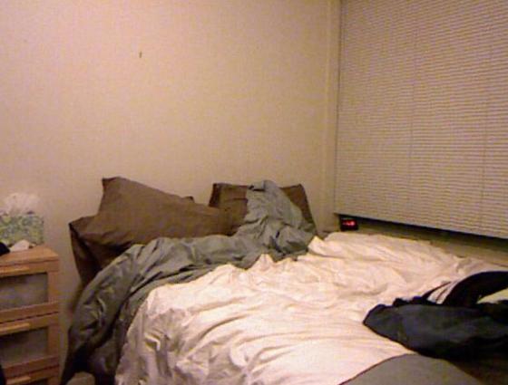
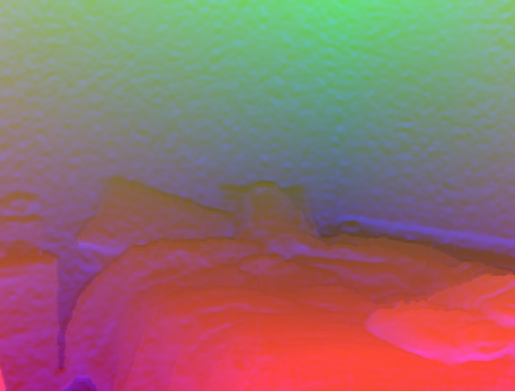
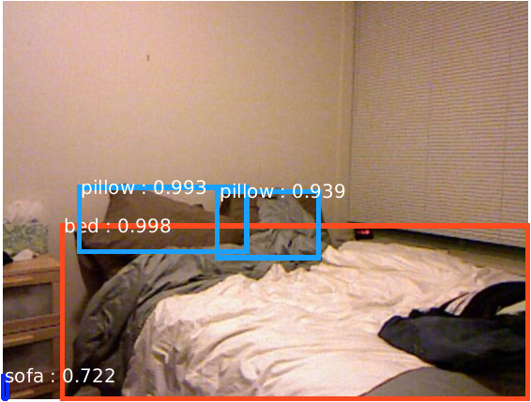
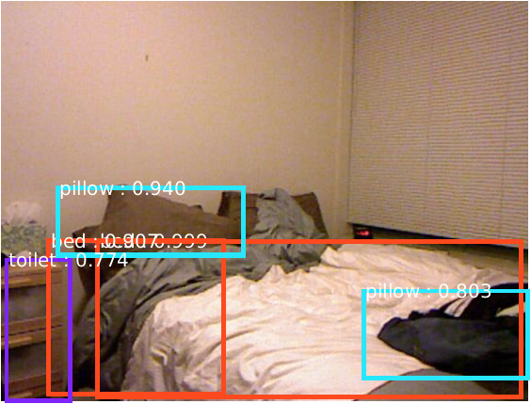
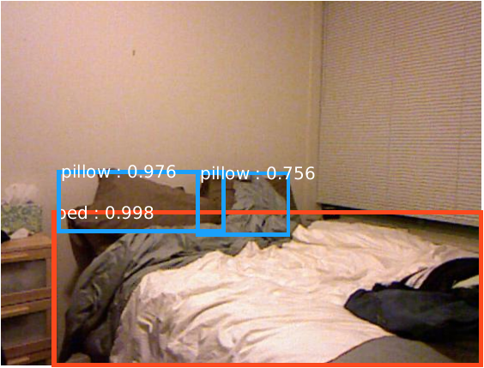
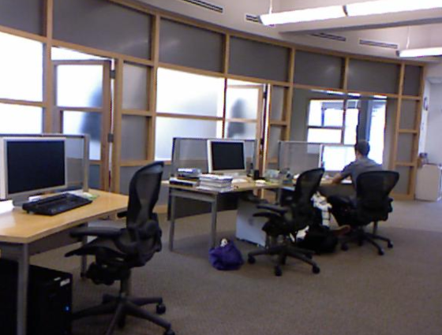
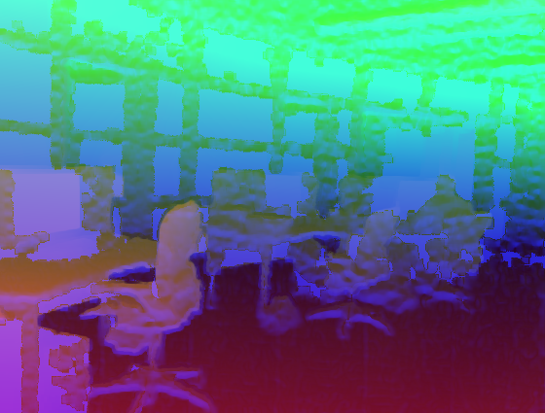
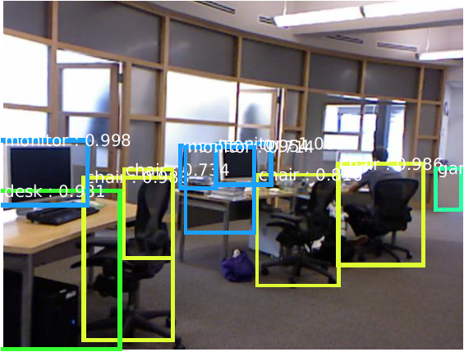
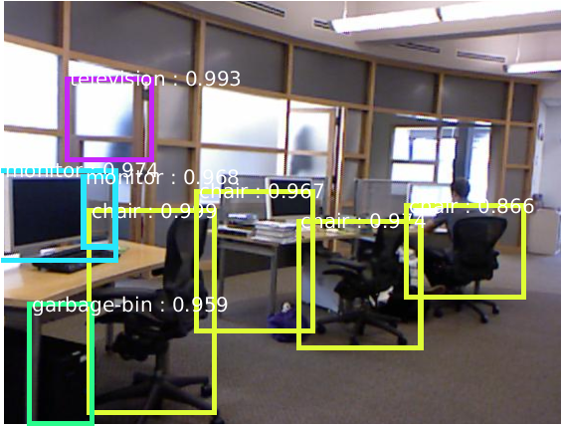
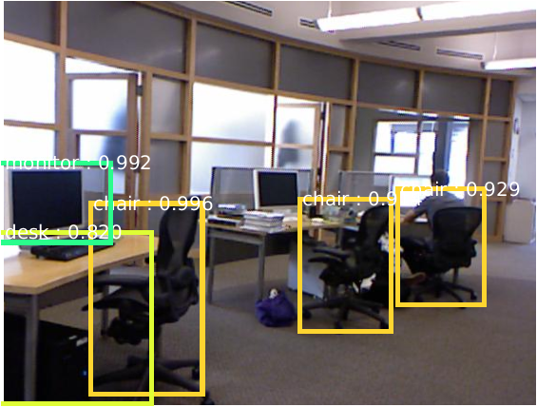
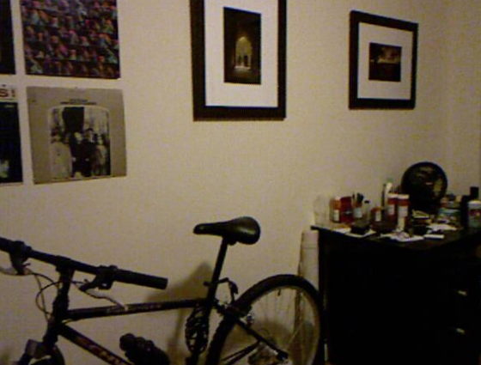
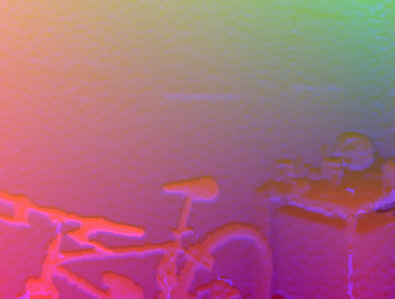
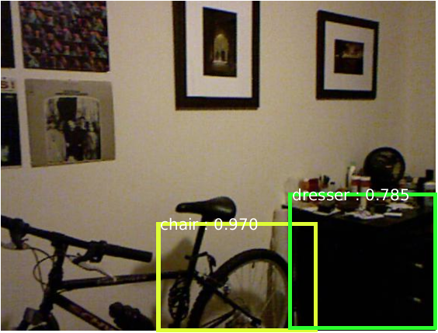
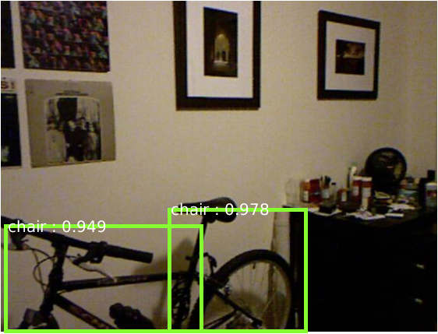
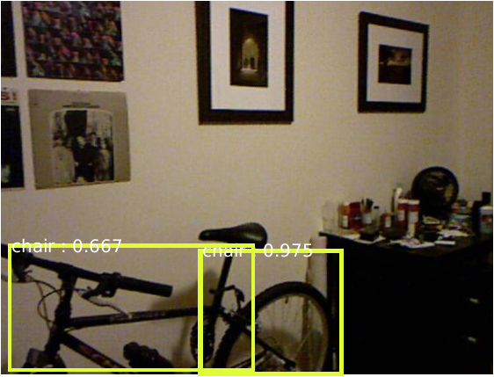
Single vs Two Modalities
RGB images
HHA images
RGB Detection
HHA detection
RGB+HHA Detection
RGB-D Object Detection using the Fast R-CNN
-Xiaoqiang Yan (CICS, UMass Amherst)

Slide 10
Conclusion
Importance of pre-trained model
ImageNet pre-trained VGG16 is better than random initilization
Richer features from depth images perform better
HHA is better than pure disparity
Combining different modalities
Averaging scores of RGB and HHA modalities gives the best performance
Joint training is slightly worse (we have to fix first three conv layers due to GPU memory constraint)
RGB-D Object Detection using the Fast R-CNN
-Xiaoqiang Yan (CICS, UMass Amherst)

